Slide 1
Farmer education, farm efficiency and agricultural productivity in Ghana: Is there a nexus?
Jacob Asravor¹, Francis Tsiboe², Mark Appiah-Twumasi³, Emmanuel Donkor⁴, Ernestina Wiafe⁵, Victor Owusu⁶
¹ Hans-Ruthenberg-Institute (490a), University of Hohenheim, Germany
² USDA, Economic Research Service, Kansas City, MO, United States of America
³ University for Development Studies, Ghana
⁴ Justus-Liebig-Universität Giessen, Germany
⁵ College of Education, Kansas State University, United States of America
⁶ Kwame Nkrumah University of Science and Technology, Ghana
vAPW2023: Virtual African Productivity Conference
December 14 - 16, 2023, Jönköping University, Sweden
The findings and conclusions of this study are those of the authors and should not be construed to represent any official USDA or U.S. Government determination or policy.

Slide 2
Outline
Background
Dataset
Research Methodology
Results and Discussion
Conclusions
References

Slide 3
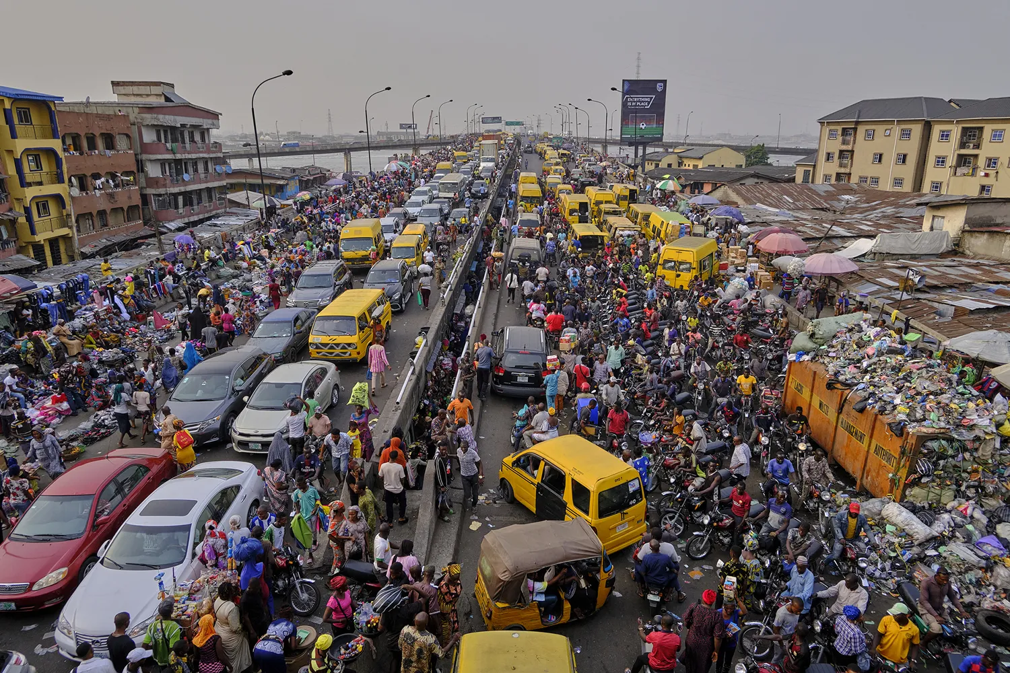
Background
Most of the population growth until 2100 is expected to take place in Africa (UN, 2019)
As a result:
Food production must increase by 60-110% to meet demand (Lal, 2016; Tilman et al., 2011)
Competition for land resources: food production vs. settlement
Since 2000, expanded area accounted for 75% of agricultural output growth in Africa (Jayne & Sanchez, 2021)
Heightened climate change impacts
Destruction of the natural resource base
Continued reliance on area expansion has resulted in enormous yield gaps on existing croplands
could raise crop output by 45-70% when exploited (Mueller et al., 2012)
Thus, sustainable expansion of crop yields on current lands offers an enormous potential for agricultural productivity growth in Africa
Source: Adeyinka Yusuf/Anadolu Agency via Getty Images

Slide 4
Background cont’d
Agricultural productivity growth: technology adoption or efficiency improvement (Fuglie et al., 2020; FAO, 2017)
Evidence indicate that technology adoption continue to be slow in SSA (Duflo et al., 2011; Dzanku et al., 2020; Rodenburg et al., 2020)
Available option is to improve the efficiency of use of deployed farm resources (Jayne & Sanchez, 2021)
The efficiency of agricultural production is substantially influenced by human capital (Hoang-Khac et al., 2021; Qian & Jie, 2022)
Education is widely regarded as the most critical form of human capital (Becker, 1993; Huffman, 2001; Phillips, 1994)
However, evidence of its impacts on farm efficiency and agricultural productivity has been inconclusive
Notes:
And those who have adopted some of these technologies are not making the most use of them

Slide 5
Background cont’d
For instance, evidence point to the productivity- and/or efficiency-enhancing impacts of education (Asadullah & Rahman, 2009; Reimers & Klasen, 2013; Ninh, 2021; Seyoum et al., 1998)
Education has a negative effect on farm efficiency and productivity (Hasnah et al., 2004; Coelli and Fleming, 2004; Ahimbisibwe et al., 2024)
Education has no effect on farm efficiency and productivity (Coelli et al., 2002; Deb, 1995; Wadud & White, 2000; Battese & Coelli, 1995)
Education only have an impact when it comes to the adoption new varieties (Azhar, 1991)
Mixed evidence, either due to how education is measured or the estimation techniques used
No evidence on this interplay in Ghana → close the gap on this relationship for Ghana, while contributing to the debate on this interplay

Slide 6
Dataset
Sixth and seventh waves of the Ghana Living Standards Survey (GLSS), fielded in 2012/13 and 2016/17, respectively
Data were based on nationally representative samples, focusing on the household as the key socio-economic unit to provide insights into living conditions in Ghana
Detailed information on the demographic characteristics of the households, education, health, employment, migration and remittances, agriculture, ICT, non-farm enterprises, financial services, anthropometry and asset (GSS, 2019)
A total of 17,534 farm households were used for the study

Slide 7
Research Methodology
Categorise farm managers into two groups; attained some form of formal education vs. no formal education
A deeper look into the various levels and components of formal educational attainment
Out of the 11,340,947 persons engaged in agriculture in Ghana,
(GSS, 2020)
Educational status | Percentages
Never attended | 27.20
Basic education | 57.20
Secondary/vocational | 12.10
Post-secondary diploma | 0.40
Tertiary | 3.10
Literacy | Percentages
Non-literate | 34.20
Literate | 65.80
*English only | 12.80
*Ghanaian lang. only | 13.60
*English & GH lang. | 38.40
*English & French | 0.10
*Eng., French & GH. lang. | 0.10
Other languages | 0.80

Slide 8
Research Methodology
SFA is backed by the assumption that a single production technology characterizes all sampled farms (Villano et al., 2010)
However, differences in the educational level of farmers could drive them to adopt different production technologies
Assuming equal technology when indeed they differ risk attributing unobserved differences in production technology to inefficiency (Villano et al., 2010)
Hence, the SFA cannot be used to compare cross-country, cross-regional or multiple technology technical efficiencies
The SMF is an envelope for all group (educational levels) frontiers, and the group frontiers are boundaries of restricted technology sets

Slide 9



Research Methodology
Stochastic Meta-Frontier Model
Output (Y)
Source: Adapted from Battese et al., (2004)
$$X_{i}$$
Meta-frontier ≡ ƒ(β*; )
Educated (Ed) ≡ $ƒ_{Ed}{(β}_{Ed};X_{i})$
No education (No) ≡ $ƒ_{No}{(β}_{No};X_{i})$
Input (X)

Slide 10
Results and Discussion
 |  |  | National | Meta-frontier
 | Non-educated | Educated
Land | 0.540*** (0.003) | 0.609*** (0.001) | 0.578*** (0.002) | 0.670*** 0.019)
Quantity of seed | 0.033*** 0.000) | 0.022*** (0.000) | 0.025*** (0.000) | 0.011*** (0.004)
Family labor | 0.248*** (0.002) | 0.258*** (0.001) | 0.253*** (0.001) | 0.162*** (0.027)
Hired labor | 0.014*** (0.000) | 0.013*** (0.000) | 0.014*** (0.000) | 0.015*** (0.001)
Fertilizer | 0.014*** (0.000) | 0.014*** (0.000) | 0.014*** (0.000) | 0.010*** (0.003)
Pesticide | 0.012*** (0.000) | 0.012*** (0.000) | 0.012*** (0.000) | 0.019*** (0.002)
Returns to scale | 0.896*** (0.001) | 0.861*** (0.002) | 0.928*** (0.002) | 0.887*** (0.016)

Slide 11
Results and Discussion
 | TGR | TE | MTE
Formal education status
Non-educated | 0.862*** (0.023) | 0.635*** (0.002) | 0.543*** (0.017)
Some form of education | 0.888*** (0.009) | 0.616*** (0.002) | 0.543*** (0.006)
Formal education level
Uneducated | 0.905*** (0.002) | 0.635*** (0.002) | 0.578*** (0.002)
Primary Education | 0.887*** (0.001) | 0.708*** (0.011) | 0.631*** (0.011)
Junior Secondary School (JSS) | 0.873*** (0.001) | 0.607*** (0.002) | 0.531*** (0.002)
Senior Secondary School (SSS) | 0.870*** (0.001) | 0.570*** (0.007) | 0.498*** (0.006)
post-SSS | 0.895*** (0.001) | 0.670*** (0.011) | 0.604*** (0.010)
Years of education quintile
First | 0.904*** (0.002) | 0.635*** (0.002) | 0.577*** (0.002)
Second | 0.888*** (0.001) | 0.708*** (0.011) | 0.632*** (0.011)
Third | 0.889*** (0.002) | 0.671*** (0.040) | 0.601*** (0.035)
Fourth | 0.873*** (0.001) | 0.607*** (0.002) | 0.532*** (0.002)
Fifth | 0.869*** (0.001) | 0.541*** (0.002) | 0.472*** (0.002)
Numeracy
Cannot do written calculations | 0.917*** (0.027) | 0.638*** (0.001) | 0.589*** (0.020)
Can do written calculations | 0.889*** (0.013) | 0.599*** (0.001) | 0.535*** (0.008)
Ghanaian language literacy
Cannot write/read | 0.907*** (0.001) | 0.624*** (0.001) | 0.569*** (0.001)
Can write/read | 0.882*** (0.001) | 0.595*** (0.001) | 0.527*** (0.001)
English/French literacy
Cannot write/read | 0.911*** (0.008) | 0.630*** (0.001) | 0.578*** (0.006)
Can write/read | 0.890*** (0.006) | 0.597*** (0.001) | 0.535*** (0.003)

Slide 12
Conclusions
Formal education appears not to have any considerable influence on farm efficiency and agricultural productivity in Ghana;
Rudimentary agricultural technology landscape in Ghana
Extensive promotion of technological packages via diverse interventions in the country – PFJ, fertilizer subsidy programs, etc.
Reinforce the general perception of farming being a profession for the poor and less educated (off-farm)

Slide 13
References
Asadullah, M.N. & Rahman, S. (2009). Farm productivity and efficiency in rural Bangladesh: the role of education revisited, Applied Economics, 41:1, 17-33
Becker, G.S. (1993). Human Capital, 3rd edn. (The University of Chicago Press, Chicago, IL)
Coelli, T., Rahman, S. & Thirtle, C. (2002). Technical, allocative, cost and scale efficiencies in Bangladesh rice cultivation: a non-parametric approach. J Agr Econ 53(3):607–626.
Duflo, E., Kremer, M. & Robinson, J. (2011). Nudging Farmers to Use Fertilizer: Theory and Experimental Evidence from Kenya. Am. Econ. Rev. 101, 2350–2390.
Dzanku, F.M., Osei, R.D., Nkegbe, P.K. & Osei-Akoto, I. (2020). Information delivery channels and agricultural technology uptake: experimental evidence from Ghana. Eur. Rev. Agric. Econ.
Fuglie, K., Gautam, M., Goyal, A. & Maloney, W.F. (2020). Harvesting Prosperity: Technology and Productivity Growth in Agriculture. Washington, DC: World Bank. doi:10.1596/978-1-4648-1393-1.
Jayne, T.S., Snapp, S., Place, F. & Sitko, N. (2019). Sustainable agricultural intensification in an era of rural transformation in Africa. Glob. Food Secur., 20,105-113.
Jayne, T.S. & Sanchez, P.A. (2021). Agricultural productivity must improve in sub-Saharan Africa. Science 4;372(6546):1045-1047.
Reimers, M. & Klasen, S. (2013). Revisiting the role of education for agricultural productivity. Amer. J of Ag. Econ., 95: 131-152.
Rodenburg, J., Büchi, L. & Haggar, J. (2020). Adoption by adaptation: moving from Conservation Agriculture to conservation practices. Int. J. Agric. Sustain. 1–19.
Ninh, L.K. (2021). Economic role of education in agriculture: Evidence from rural Vietnam. Journal of Economics and Development, 23(1), 47–58.
Wadud, A. & White, B. (2000). Farm household efficiency in Bangladesh: a comparison of stochastic frontier and DEA methods. Appl Econ 32(13):1665–1673.

Slide 14

Acknowledgement

Slide 15

Thank you very much for your attention

